Slide 1

Hackathon 2016
Team
Ajaya Loya
Andrea Midea
Andre Souza
Guilherme Cardoso
Marcus Barcelos

Slide 2

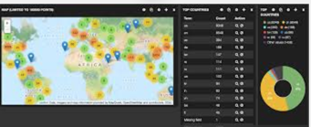
How to interact real-time with FIA Alerts ?
Why Choose Alexa?
Features like building own skill set
Easy to teach Alexa using keywords
Real Time Dashboard using Geo Mappings
Instant update on dashboard which works seamless on any device which has browser in it.

Slide 3









Source Code Links:
Frontend
Lambda Function
CloudFormation
HTTPS
HTTPS
Invoke
Store/Fetch Record/s
HTTPS POST
Response
Get
Records
API Gateway
AWS Lambda
API DynamoDB
HTTPS
HTTPS
https://goo.gl/zaj3cq
Serverless Architecture
Amazon S3

Slide 4
Demo
https://goo.gl/zaj3cq

Slide 5
Possible Enhancements
>> Alexa can inform respective authorities directly.
>> Analytics using the existing data

